Slide 1
Capstone Project-2 Regression
Bike Sharing Demand Prediction
By
Ashish Wasnik

Slide 2
1) BUSINESS UNDERSTANDING 2) DATA SUMMARY 3) FEATURE ANALYSIS 4) EXPLORATORY DATA ANALYSIS 5) DATA PREPROCESSING 6) IMPLEMENTING ALGORITHMS 7) CHALLENGES 8) CONCLUSIONS
CONTENT

Slide 3
BUSINESS UNDERSTANDING
➢ Bike rentals have became a popular service in recent years and it seems that people are using it more often. With relatively cheaper rates and ease of pick up and drop at own convenience is what making this business thrive.
➢ Mostly used by people having no personal vehicles and also to avoid congested public transport, they prefer rental bikes.
➢ Therefore, the business to strive and profit more, it has to be always ready and supply no. of bikes at different locations, to fulfil the demand.
➢ Our project goal is a pre planned set of bike count values that can be a handy solution to meet all demands.

Slide 4
DATA SUMMARY
 | Date | Rented Bike Count | Hour | Temperature(°C) | Humidity(%) | Wind speed (m/s) | Visibility (10m) | Dew point temperature(°C) | Solar Radiation (MJ/m2) | Rainfall(mm) | Snowfall (cm) | Seasons | Holiday | Functioning Day
8755 | 30/11/2018 | 1003 | 19 | 4.2 | 34 | 2.6 | 1894 | -10.3 | 0.0 | 0.0 | 0.0 | Autumn | No Holiday | Yes
8756 | 30/11/2018 | 764 | 20 | 3.4 | 37 | 2.3 | 2000 | -9.9 | 0.0 | 0.0 | 0.0 | Autumn | No Holiday | Yes
8757 | 30/11/2018 | 694 | 21 | 2.6 | 39 | 0.3 | 1968 | -9.9 | 0.0 | 0.0 | 0.0 | Autumn | No Holiday | Yes
8758 | 30/11/2018 | 712 | 22 | 2.1 | 41 | 1.0 | 1859 | -9.8 | 0.0 | 0.0 | 0.0 | Autumn | No Holiday | Yes
8759 | 30/11/2018 | 584 | 23 | 1.9 | 43 | 1.3 | 1909 | -9.3 | 0.0 | 0.0 | 0.0 | Autumn | No Holiday | Yes
➢ This Dataset contains 8760 lines and 14 columns.
➢ Three categorical features ‘Seasons’, ‘Holiday’, & ‘Functioning Day’.
➢ One Datetime features ‘Date’.
➢ We have some numerical type variables such as temperature, humidity, wind, visibility, dew point temp, solar radiation, rainfall, snowfall which tells the environment conditions at that particular hour of the day.

Slide 5
FEATURE SUMMARY
➢ Date : Year-Month-Day
➢ Rented Bike Count - Count of bikes rented at each hour
➢ Hour - Hour of the day
➢ Temperature - Temperature in Celsius
➢ Humidity - %
➢ Wind Speed - m/s
➢ Visibility - 10m
➢ Dew point temperature -Celsius
➢ Solar radiation -MJ/m2
➢ Rainfall -mm
➢ Snowfall –cm
➢ Seasons -Winter, Spring, Summer, Autumn
➢ Holiday -Holiday/No Holiday
➢ Functional Day - NoFunc(Non Functional Hrs),Fun(Functional Hrs)

Slide 6
INSIGHTS FROM OUR DATASET
➢ There are No Missing Values present.
➢ There are No Duplicate values present.
➢ There are No null values.
➢ And finally we have 'rented bike count' variable which we need to predict for new observations.
➢ The dataset shows hourly rental data for one year (1 December 2017 to 31 November(2018)(365 days).we consider this as a single year data.
➢ So we convert the "date" column into 3 different column i.e. "year","month","day".
➢ We change the name of some features for our convenience, they are as below: 'Rented_Bike_Count', 'Hour', 'Temperature', 'Humidity', 'Wind_speed', 'Visibility', ‘Dew_point_temperature', 'Solar_Radiation', 'Rainfall', 'Snowfall', 'Seasons', 'Holiday', 'Functioning_Day', 'month','weekdays_weekend’.

Slide 7
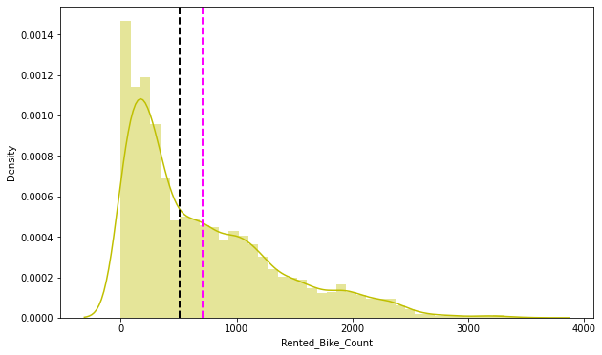
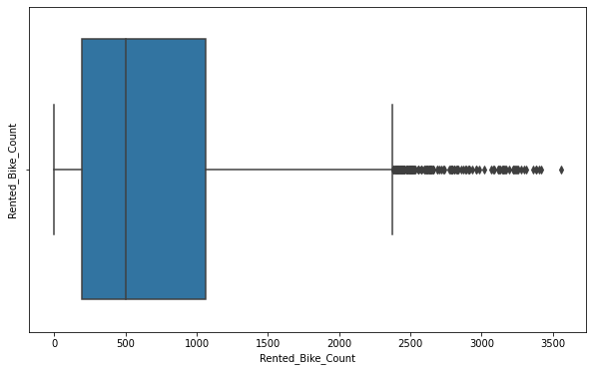
ANALYSIS OF RENTED BIKE COLUMN
➢ The above graph shows that Rented Bike Count has moderate right skewness.
➢ The above boxplot shows that we have detect outliers in Rented Bike Count column.
➢ Since the assumption of linear regression is that 'the distribution of dependent variable has to be normal', so we should perform Square root operation to make it normal.

Slide 8
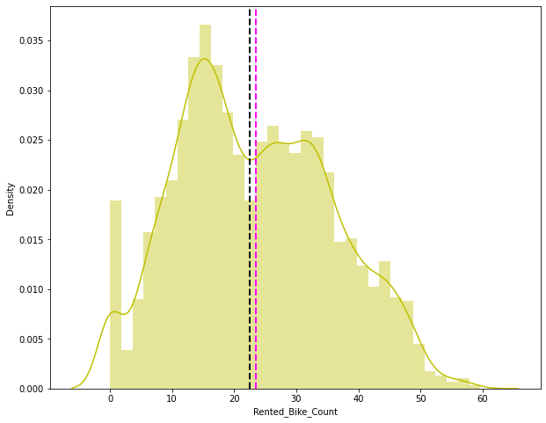
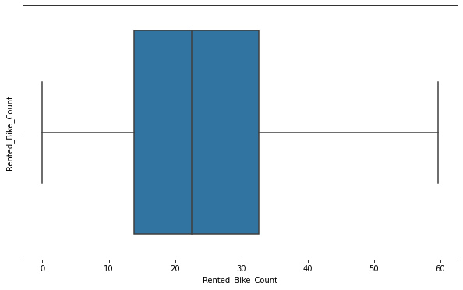
ANALYSIS OF RENTED BIKE COLUMN
➢ After applying Square root to the skewed Rented Bike Count, here we get almost normal distribution.
➢ After applying Square root to the Rented Bike Count column, we find that there is no outliers present.

Slide 9
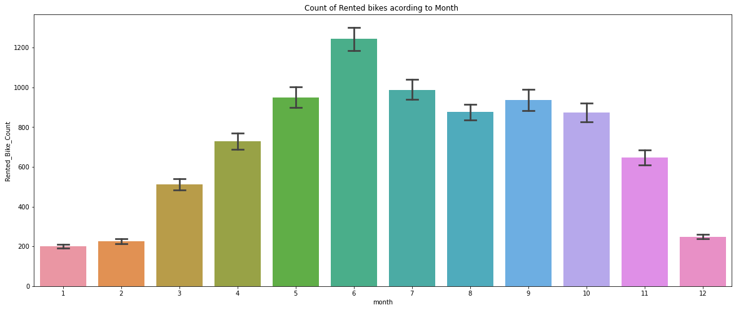
ANALYSIS OF MONTH VARIABLE
➢ From the above bar plot we can clearly say that from the month 5 to 10 the demand of the rented bike is high as compare to other months & these months comes inside the summer season.

Slide 10
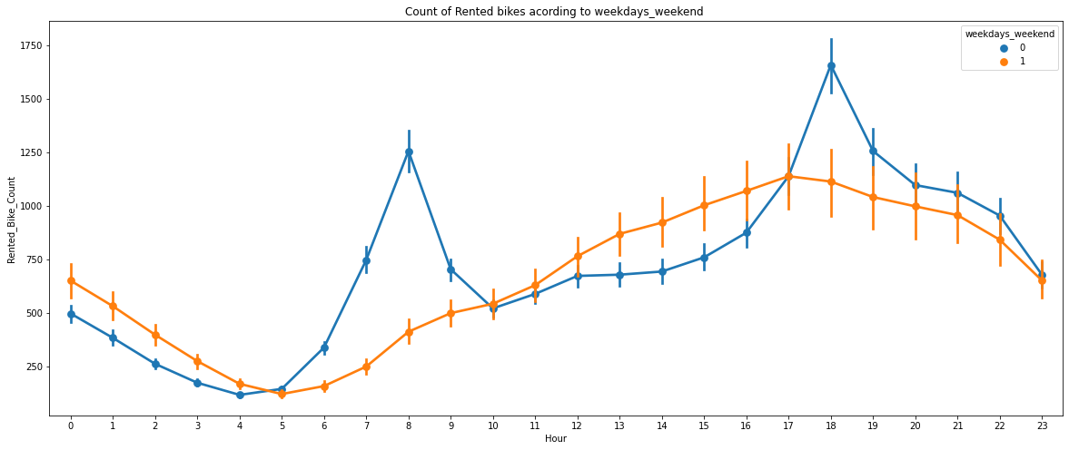
ANALYSIS OF WEEKDAYS_WEEKEND VARIABLE
● From the above point plot and bar plot we can say that in the weekdays which
represent in blue colour show that the demand of the bike is higher because of the
office.
● Peak Time are 7 am to 9 am and 5 pm to 7 pm
● The orange color represent the weekend days, and it show that the demand of rented bikes are very low especially in the morning hour but when the evening start from 4 pm to 8 pm the demand slightly increases.

Slide 11
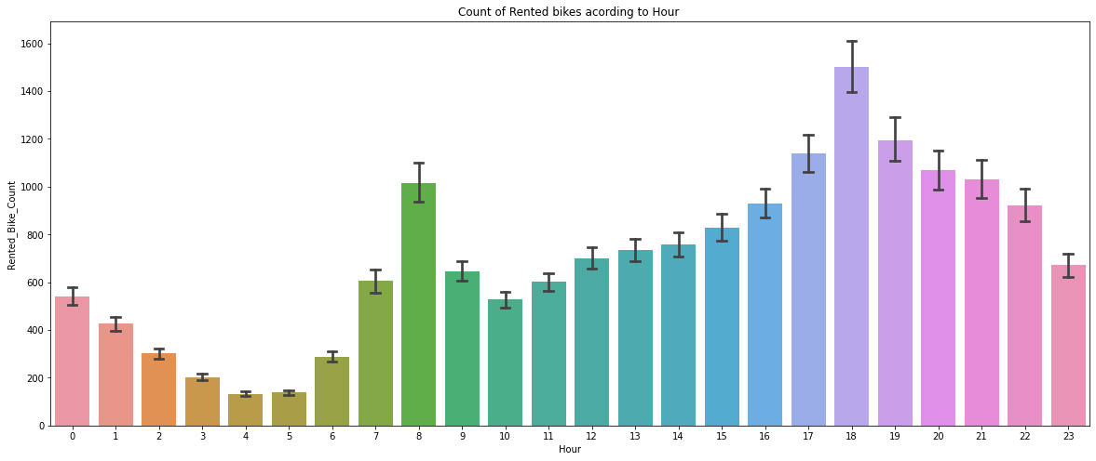
ANALYSIS OF HOUR VARIABLE
➢ In the above plot which shows the use of rented bike according the hours and the data are from all over the year.
➢ Generally people use rented bikes during their working hour from 7am to 9am and 5pm to 7pm.

Slide 12
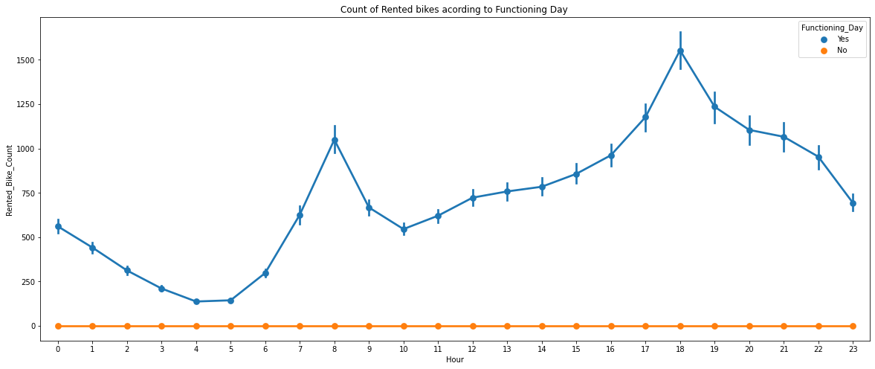
ANALYSIS OF FUNCTIONING DAY VARIABLE
➢ In the above point plot which shows the use of rented bike in functioning day or not, and it clearly shows that, peoples don’t use rented bikes in no functioning day.

Slide 13
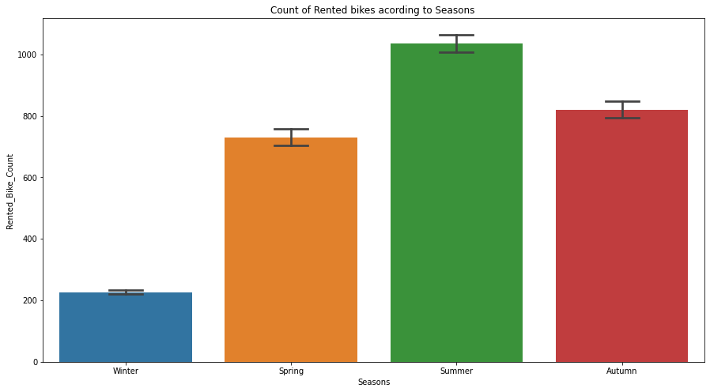
ANALYSIS OF SEASON VARIABLE
➢ This above bar plot shows the distribution of rented bike count season wise.
➢ And we can clearly see that the people love to ride bike in summer & autumn season.
➢ But in winter season people don't take any rented bike because of snowfall.

Slide 14
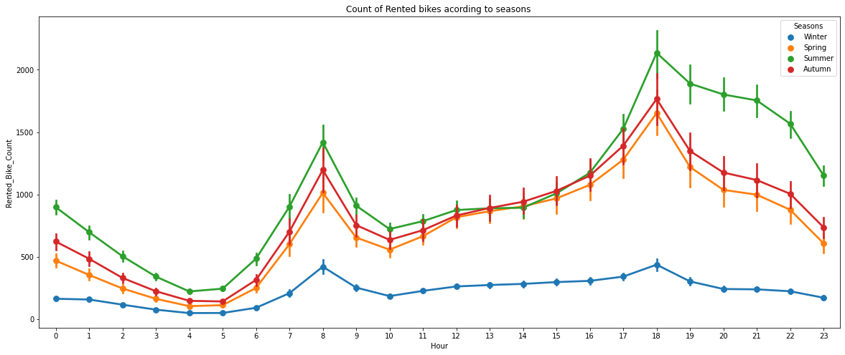
ANALYSIS OF SEASON VARIABLE
➢ In the above bar plot and point plot which shows the use of rented bike in four different seasons, and it clearly shows that:
➢ In summer season the use of rented bike is high and peak time is 7am-9am and 7pm-5pm.
➢ In winter season the use of rented bike is very low because of snowfall.

Slide 15
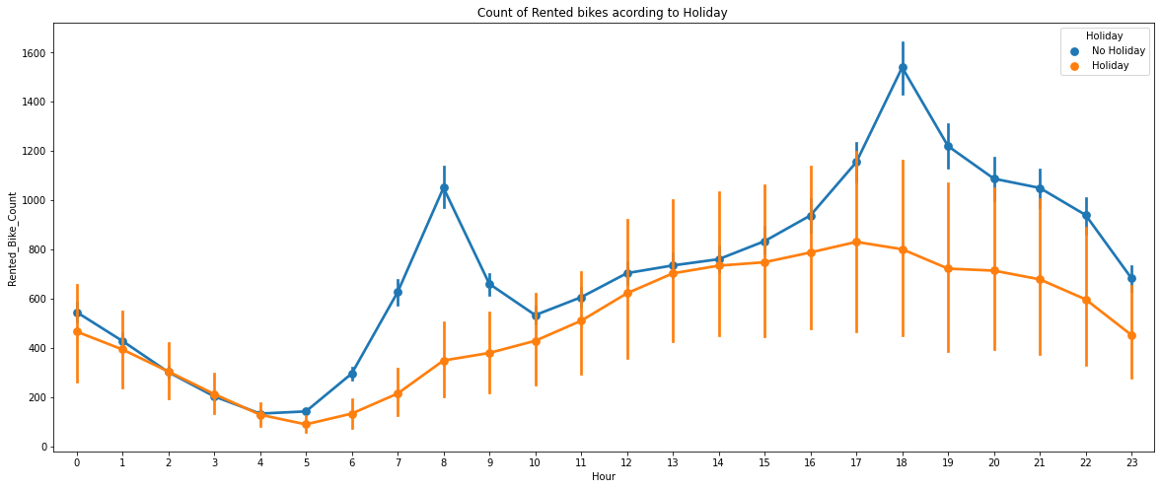
ANALYSIS OF HOLIDAY VARIABLE
➢ In the above bar plot and point plot which shows the use of rented bike in a holiday, and it clearly shows that;
➢ In holiday people use the rented bike from 2pm-8pm.

Slide 16
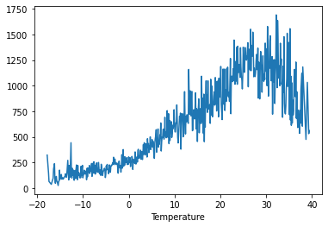
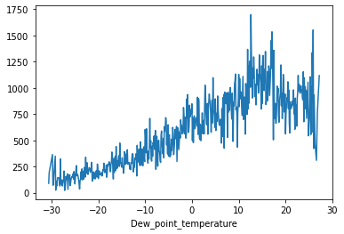
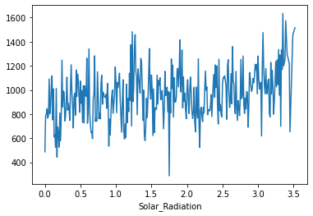
NUMERICAL VS RENTED BIKE COUNT
➢ From the above plot we see that people like to ride bikes when it’s pretty hot around 25°C in average.
➢ From the above plot of "Dew_point_temperature’ its almost same as the 'temperature’ but there is some similarity present
➢ The amount of rented bikes is huge, when there is solar radiation, the counter of rents is around 1000.

Slide 17
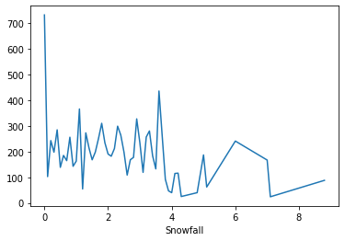
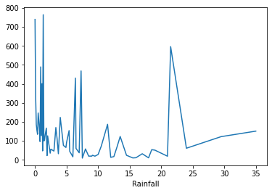
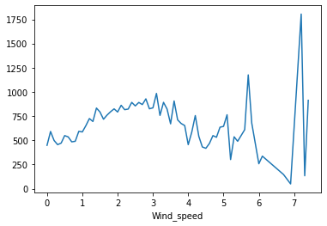
NUMERICAL VS RENTED BIKE COUNT
● In snowfall plot, on the y-axis, the amount of rented bike is very low & when we have more than 4 cm of snow, the bike rents is much lower.
● In rainfall plot if it rains a lot the demand of rent bikes is not decreasing, here for example even if we have 20 mm of rain there is a big peak of rented bikes.
● In wind speed plot the demand of rented bike is uniformly distribute despite of wind speed but when the speed of wind was 7 m/s then the demand of bike also increases that clearly means people love to ride bikes when its little windy

Slide 18
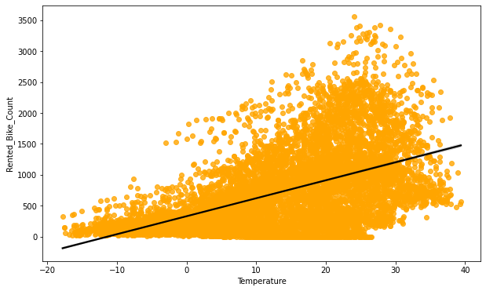
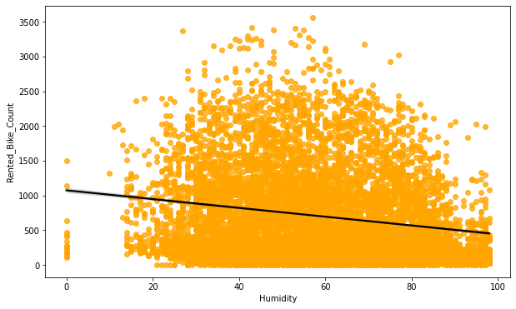
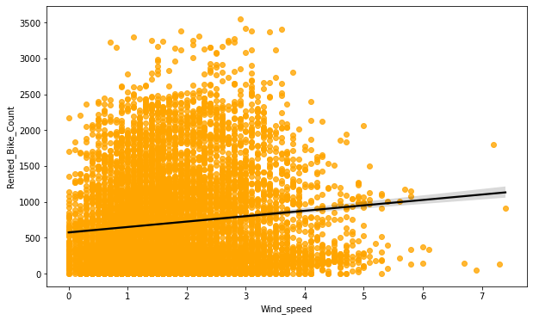
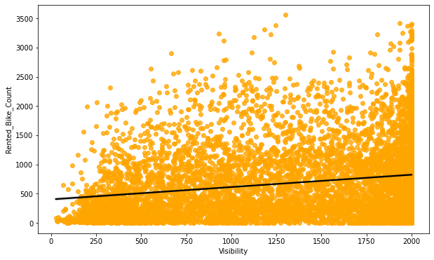
REGRESSION PLOT FOR NUMERICAL VARIABLE

Slide 19
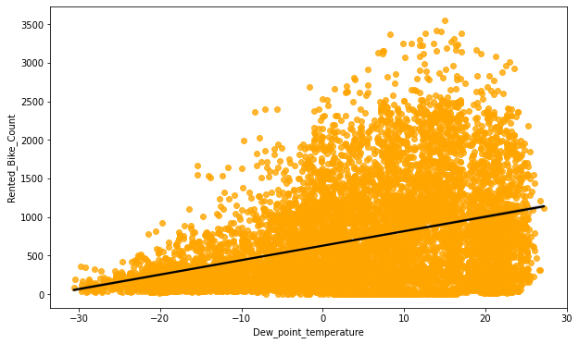
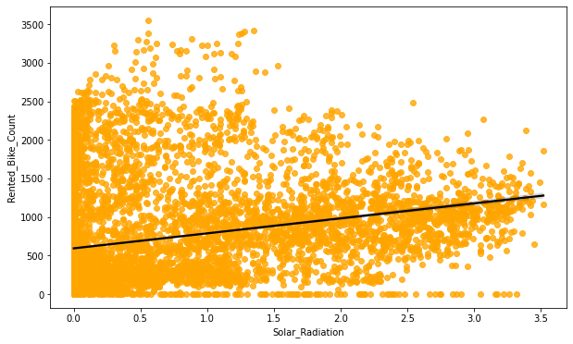
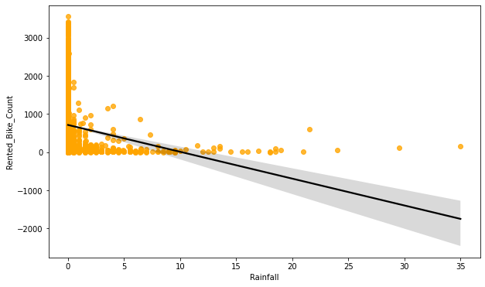
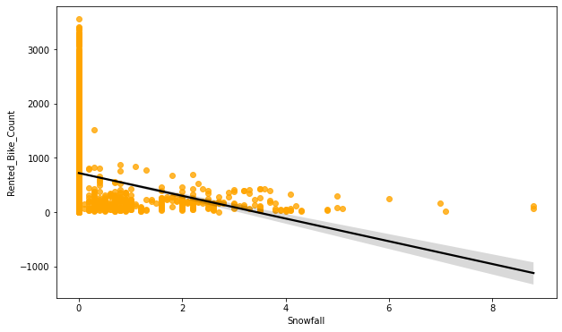
REGRESSION PLOT FOR NUMERICAL VARIABLE

Slide 20
REGRESSION PLOT FOR NUMERICAL VARIABLE
➢ From the above regression plot all numerical features we see that the columns 'Temperature’, 'Wind_speed’, 'Visibility', 'Dew_point_temperature’, 'Solar_Radiation' are positively relation to the target variable.
➢ which means the rented bike count increases with increase of these features.
➢ 'Rainfall’, 'Snowfall’, 'Humidity’ are the features that are negatively related with the target variable which means the rented bike count decreases when these features increase.

Slide 21
OLS REGRESSION MODEL
OLS Regression Results
Dep. Variable: Rented_Bike_Count R-squared: 0.398
Model: OLS Adj. R-squared: 0.397
Method: Least Squares F-statistic: 723.1
Date: Thu, 21 Apr 2022 Prob (F-statistic): 0.00
Time: 10:09:24 Log-Likelihood: -66877.
No. Observations: 8760 AIC: 1.338e+05
Df Residuals: 8751 BIC: 1.338e+05
Df Model: 8
Covariance Type: nonrobust
coef std err t P>|t| [0.025 0.975]
const 844.6495 106.296 7.946 0.000 636.285 1053.014
Temperature 36.5270 4.169 8.762 0.000 28.355 44.699
Humidity -10.5077 1.184 -8.872 0.000 -12.829 -8.186
Wind_speed 52.4810 5.661 9.271 0.000 41.385 63.577
Visibility -0.0097 0.011 -0.886 0.376 -0.031 0.012
Dew_point_temperature -0.7829 4.402 -0.178 0.859 -9.411 7.846
Solar_Radiation -118.9772 8.670 -13.724 0.000 -135.971 -101.983
Rainfall -50.7083 4.932 -10.282 0.000 -60.376 -41.041
Snowfall 41.0307 12.806 3.204 0.001 15.929 66.133
Omnibus: 957.371 Durbin-Watson: 0.338
Prob(Omnibus): 0.000 Jarque -Bera (JB): 1591.019
Skew: 0.769 Prob(JB): 0.00
Kurtosis: 4.412 Cond. No. 3.11e+04
➢ R square and Adj Square are near to each other. 40% of variance in Rented Bike count is explained by the model.
➢ P value of dew point temp and visibility are very high and they are not significant.
Warnings:
[1] Standard Errors assume that the covariance matrix of the errors is correctly specified.
[2] The condition number is large, 3.11e+04. This might indicate that there are
strong multicollinearity or other numerical problems.

Slide 22
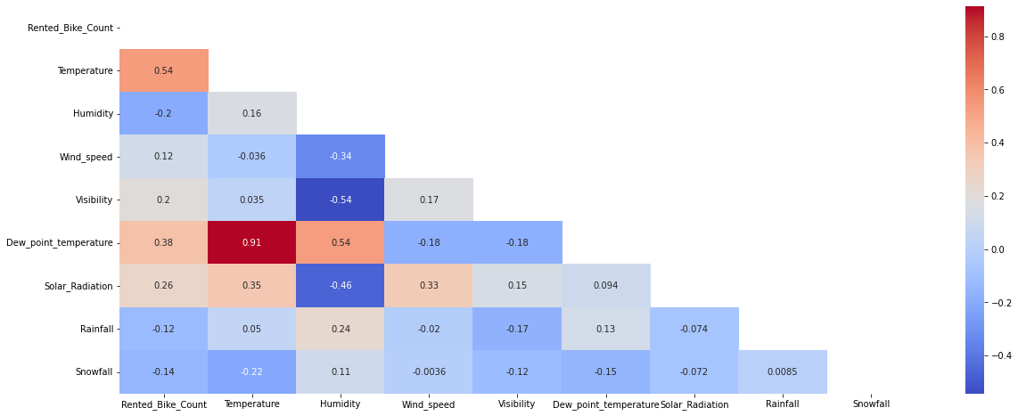
CORRELATION MATRIX
➢ Variables like Dew Point Temperature, and Temperature are highly correlated.

Slide 23
MODEL BUILDING
➢ LINEAR REGRESSION
➢ LASSO REGRESSION
➢ RIDGE REGRESSION
➢ DECISION TREES REGRESSOR
➢ RANDOM FOREST REGRESSOR
➢ GRADIENT BOOSTED REGRESSOR
➢ GRADIENT BOOSTING REGRESSOR WITH GRIDSEARCHCV

Slide 24
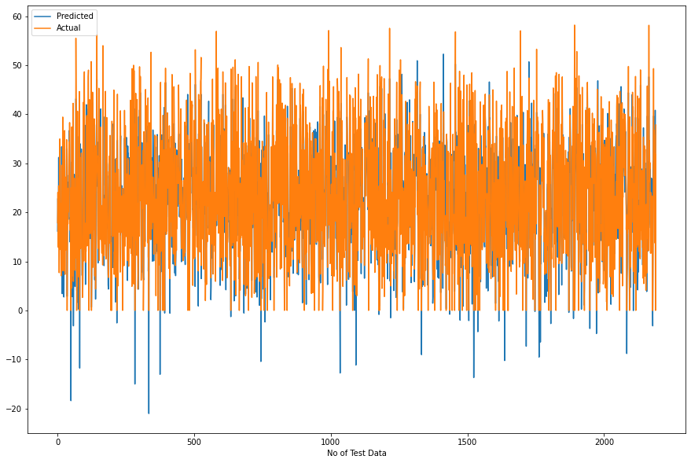
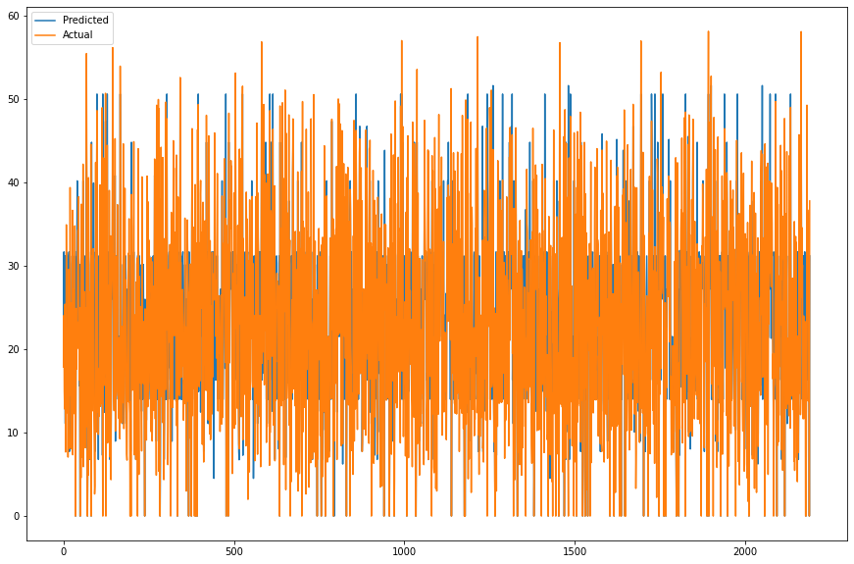
LINEAR REGRESSION DECISION TREE
Train Set Results Test Set Results Train Set Results Test Set Results
MSE : 35.07751288189293
RMSE : 5.9226271942350825
MAE : 4.474024092996787
R2 : 0.7722101548255267
Adjusted R2 : 0.7672119649454145
MSE : 33.27533089591926
RMSE : 5.76847734639907
MAE : 4.410178475318181
R2 : 0.7893518482962683
Adjusted R2 : 0.7847297833429184
Model Score: 0.6394383578950342
MSE : 55.523132016557206
RMSE : 7.451384570437712
MAE : 5.397715902312179
R2 : 0.6394383578950342
Adjusted R2 : 0.6315268746182212
MSE : 70.47040983610837
RMSE : 8.394665558323831
MAE : 5.887731533671768
R2 : 0.553889888331624
Adjusted R2 : 0.5441012911101424

Slide 25
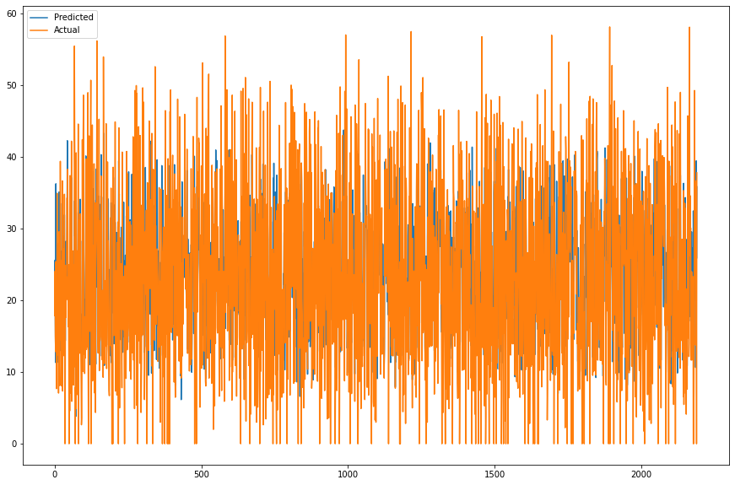
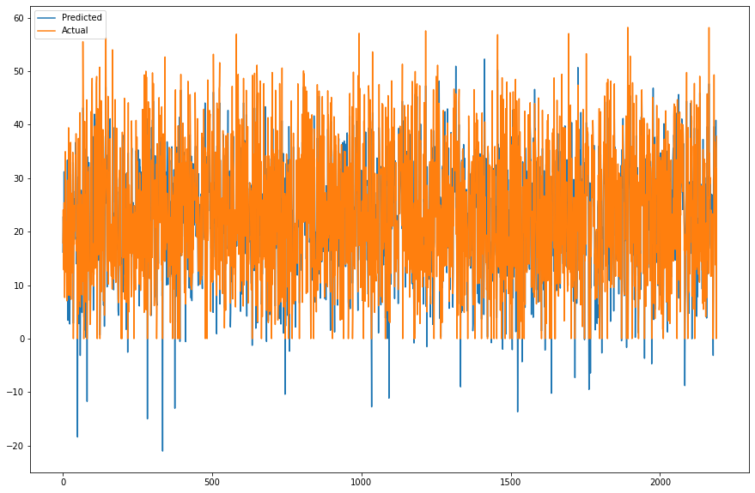
LASSO REGRESSION RIDGE REGRESSION
Train Set Results Test Set Results Train Set Results Test Set Results
MSE : 91.59423336097032
RMSE : 9.570487623991283
MAE : 7.255041571454952
R2 : 0.40519624904934015
Adjusted R2 : 0.3921449996120475
MSE : 96.7750714044618
RMSE : 9.837432155011886
MAE : 7.455895061963607
R2 : 0.3873692800799008
Adjusted R2 : 0.37392686932535146
MSE : 33.27678426818438
RMSE : 5.768603320404722
MAE : 4.410414932539515
R2 : 0.7893426477812578
Adjusted R2 : 0.7847203809491939
MSE : 35.07752456136463
RMSE : 5.922628180239296
MAE : 4.474125776125378
R2 : 0.7722100789802107
Adjusted R2 : 0.7672118874358922

Slide 26
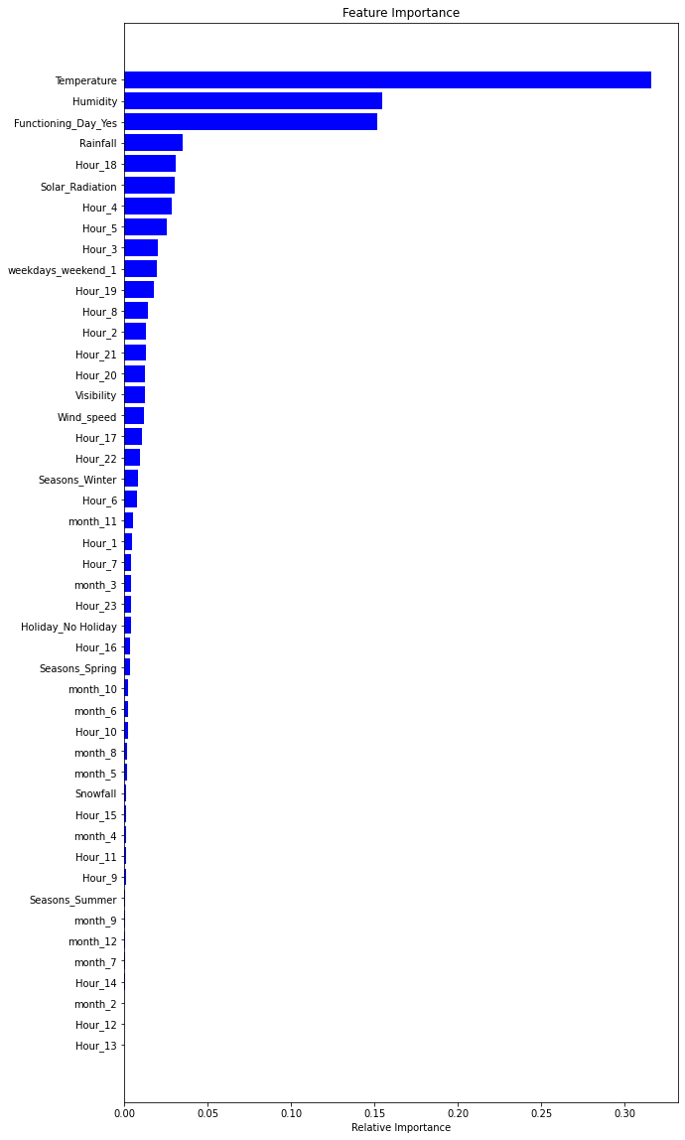
RANDOM FOREST
Train Set Results
Test Set Results
 | Feature | Feature Importance
0 | Temperature | 0.31
1 | Humidity | 0.16
34 | Functioning_Day_Yes | 0.15
10 | Hour_4 | 0.03
4 | Solar_Radiation | 0.03
5 | Rainfall | 0.03
24 | Hour_18 | 0.03
11 | Hour_5 | 0.03
25 | Hour_19 | 0.02
46 | weekdays_weekend_1 | 0.02
9 | Hour_3 | 0.02
Model Score: 0.989630285267275
MSE : 1.5968394106423371
RMSE : 1.2636611138443476
MAE : 0.8057029661218554
R2 : 0.989630285267275
Adjusted R2 : 0.9894027518441013
MSE : 12.647354312015633
RMSE : 3.556311897460012
MAE : 2.2035501760052716
R2 : 0.9199364292393849
Adjusted R2 : 0.9181796655485591

Slide 27
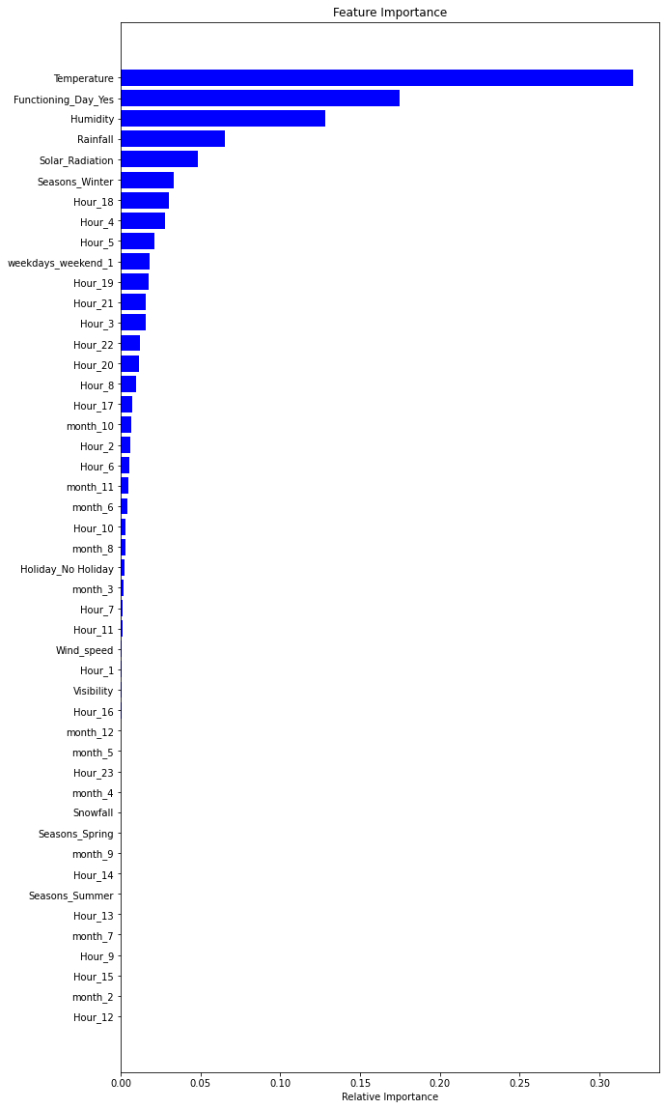
GRADIENT BOOSTING
Train Set Results
Test Set Results
 | Feature | Feature Importance
0 | Temperature | 0.32
34 | Functioning_Day_Yes | 0.17
1 | Humidity | 0.13
5 | Rainfall | 0.07
4 | Solar_Radiation | 0.05
32 | Seasons_Winter | 0.03
Model Score: 0.8789016499095264
MSE : 18.64801713184794
RMSE : 4.3183349953249275
MAE : 3.269003569273124
R2 : 0.8789016499095264
Adjusted R2 : 0.8762444965695393
MSE : 21.28944184250869
RMSE : 4.6140483138463875
MAE : 3.492858786559991
R2 : 0.8652280396863458
Adjusted R2 : 0.8622708584843188

Slide 28
GRADIENT BOOSTING REGRESSOR WITH GRIDSEARCHCV
Train Set Results
Test Set Results
Hyper parameter
Feature Feature Importance
0 Temperature 0.31
34 Functioning_Day_Yes 0.16
1 Humidity 0.15
4 Solar_Radiation 0.04
5 Rainfall 0.04
Model Score: 0.9515896672300013
MSE : 7.4547400041283725
RMSE : 2.7303369762958516
MAE : 1.8489194833919358
R2 : 0.9515896672300013
Adjusted R2 : 0.9505274423746372
MSE : 12.393403249345434
RMSE : 3.5204265720712646
MAE : 2.4007407956878812
R2 : 0.921544056287242
Adjusted R2 : 0.9198225673262245
{'max_depth': 8,
'min_samples_leaf': 40,
'min_samples_split': 50,
'n_estimators': 100}

Slide 29
CHALLENGES
➢ Large Dataset to handle.
➢ Needs to plot lot of Graphs to analyze.
➢ Feature engineering
➢ Feature selection
➢ Optimizing the model
➢ Carefully tuned Hyperparameters as it affects the R2 score.

Slide 30
CONCLUSION
➢ ‘Hour’ of the day holds the most important feature.
➢ Bike rental count is mostly correlated with the time of the day as it is peak at 10 am morning and 8 pm at evening.
➢ We observed that bike rental count is high during working days than non- working day.
➢ We see that people generally prefer to bike at moderate to high temperatures, and when little windy.
➢ It is observed that highest number bike rentals counts is in Autumn & Summer seasons & the lowest in winter season. We observed that the highest number of bike rentals on a clear day and the lowest on a snowy or rainy day. ➢ We observed that with increasing humidity, the number of bike rental counts decreases.

Slide 31
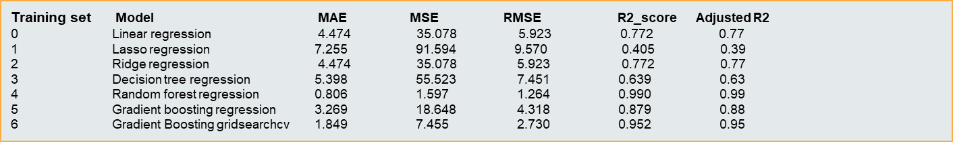
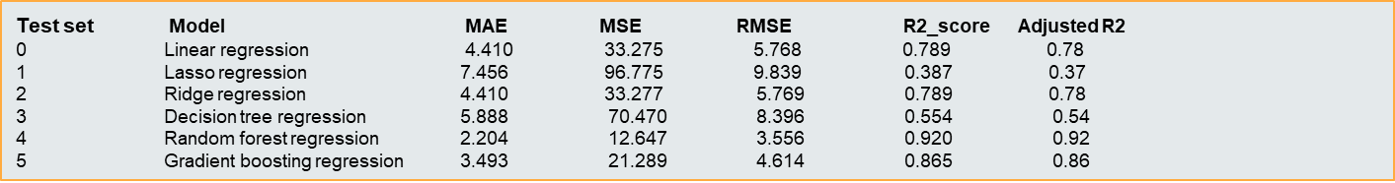
CONCLUSION
➢ When we compare the root mean squared error and mean absolute error of all the models, Random forest Regressor and Gradient Boosting gridsearchcv gives the highest R2 score of 99% and 95% respectively for Train Set and 92% for Test set. So, finally this model is best for predicting the bike rental count on daily basis.

Slide 32
THANK YOU

